Slide 1
Introduction to NCI’s Data Collections
2019 AMOS Darwin
Jingbo Wang & Kate Snow

Slide 2
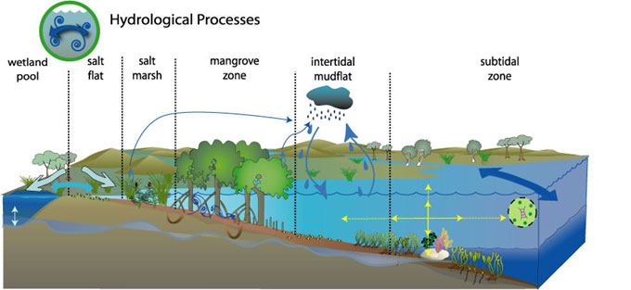
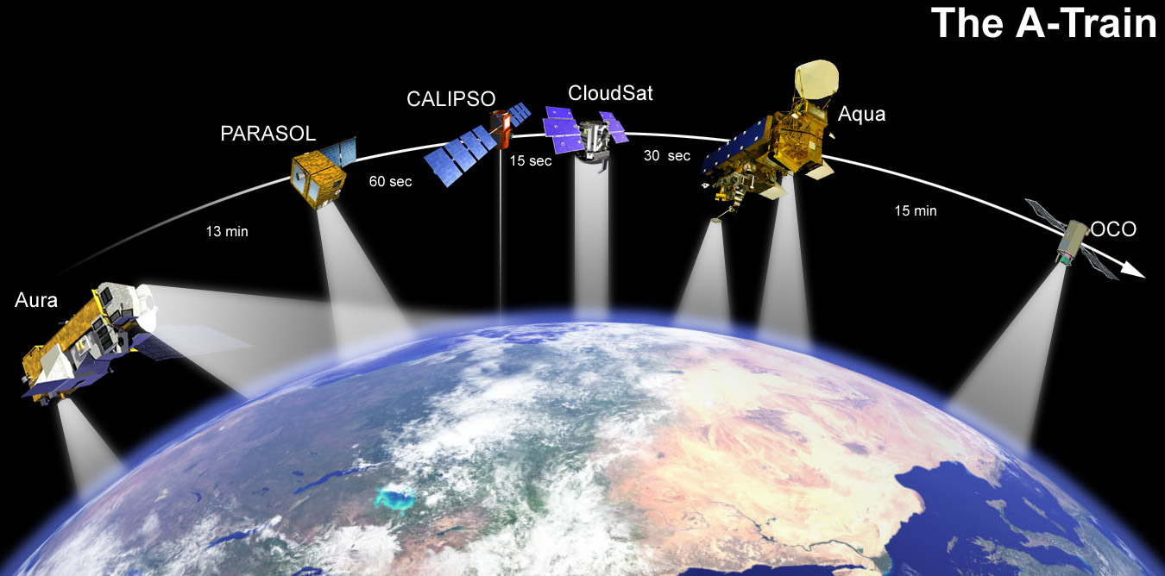
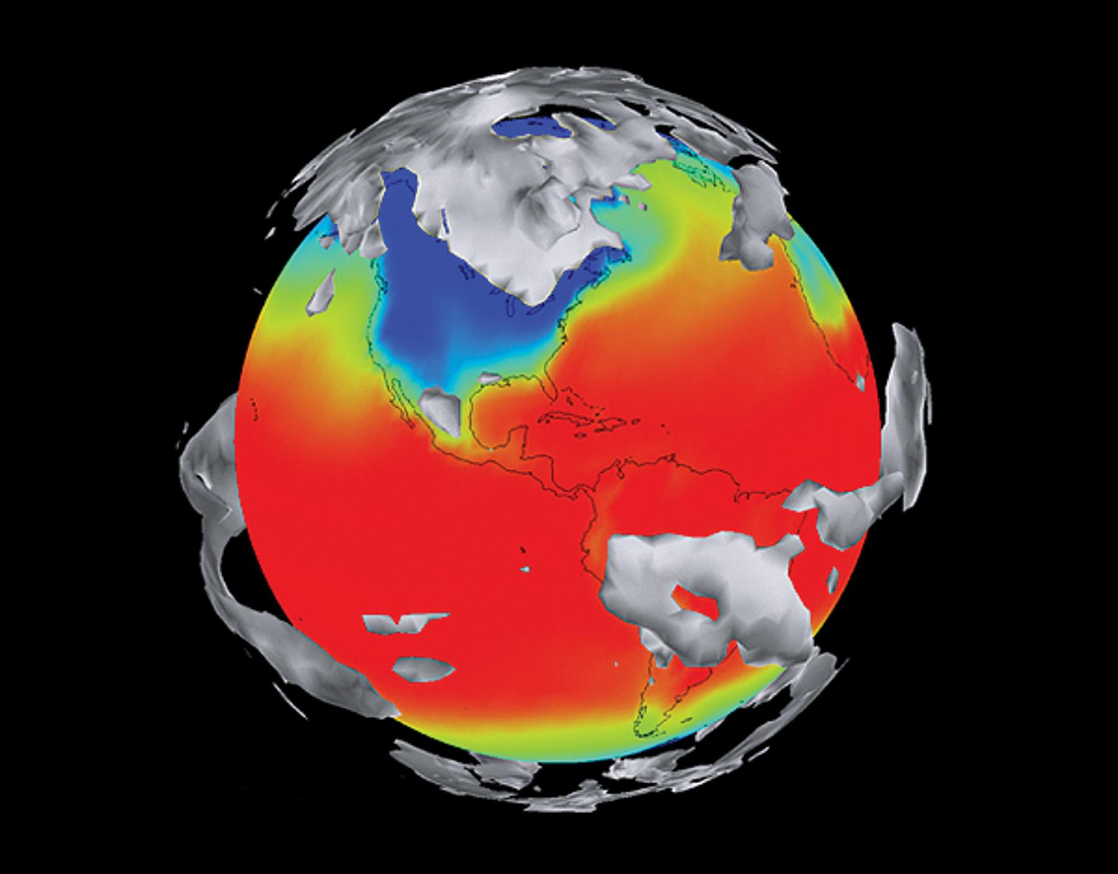
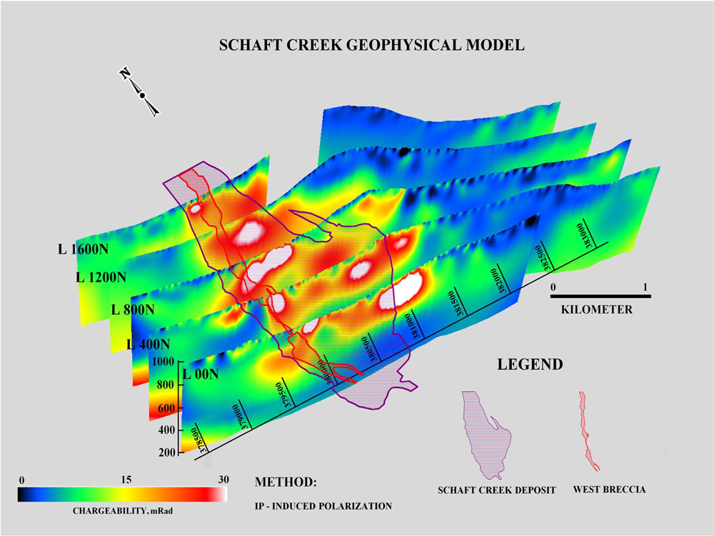
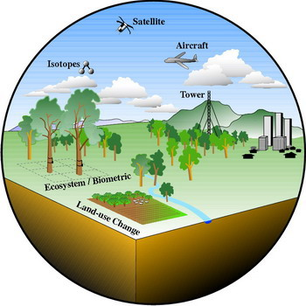


Overview
NCI makes available national reference datasets – especially those produced by the government agencies. It is brought together at NCI and organised for both high performance computation & high performance data analysis, as well as making available more broadly to the research community.
climate and weather models
satellite images
bathymetry and elevation
hydrology
geophysics
Also: optical astro, genomic and social sciences

Slide 3
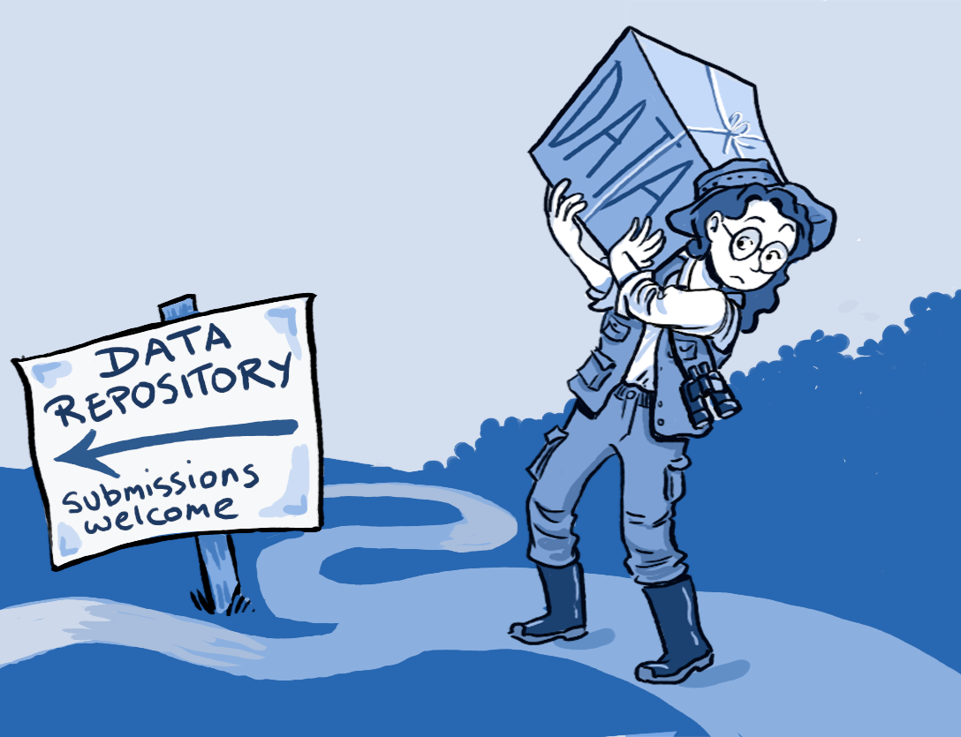



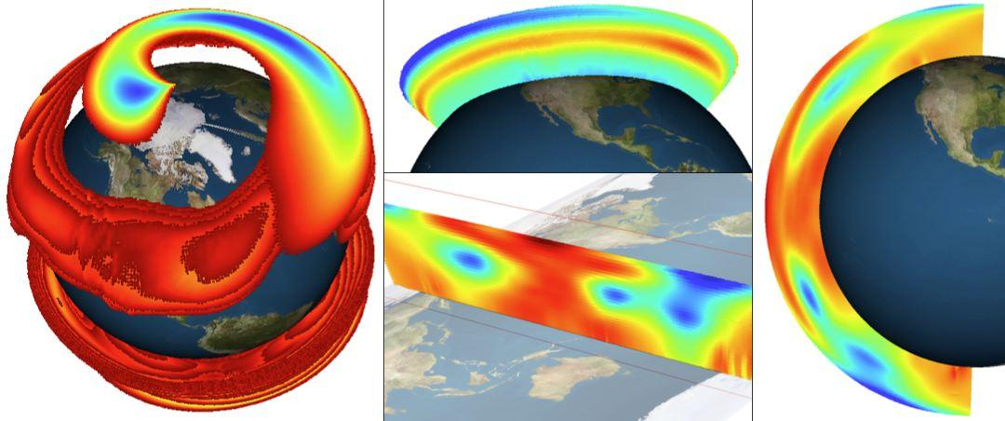

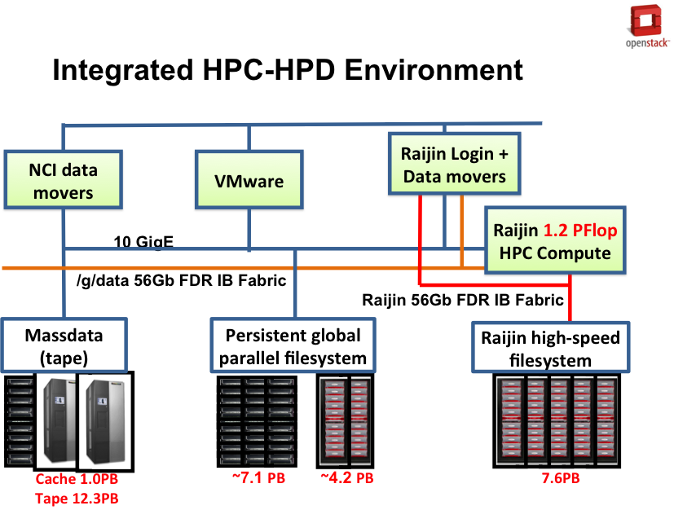
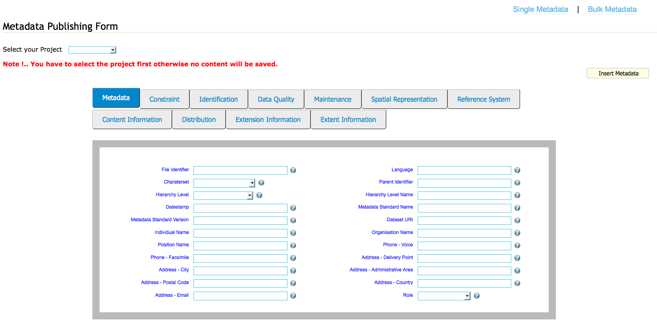

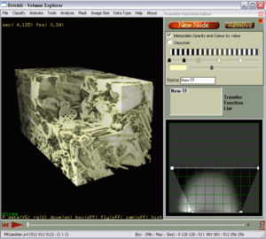
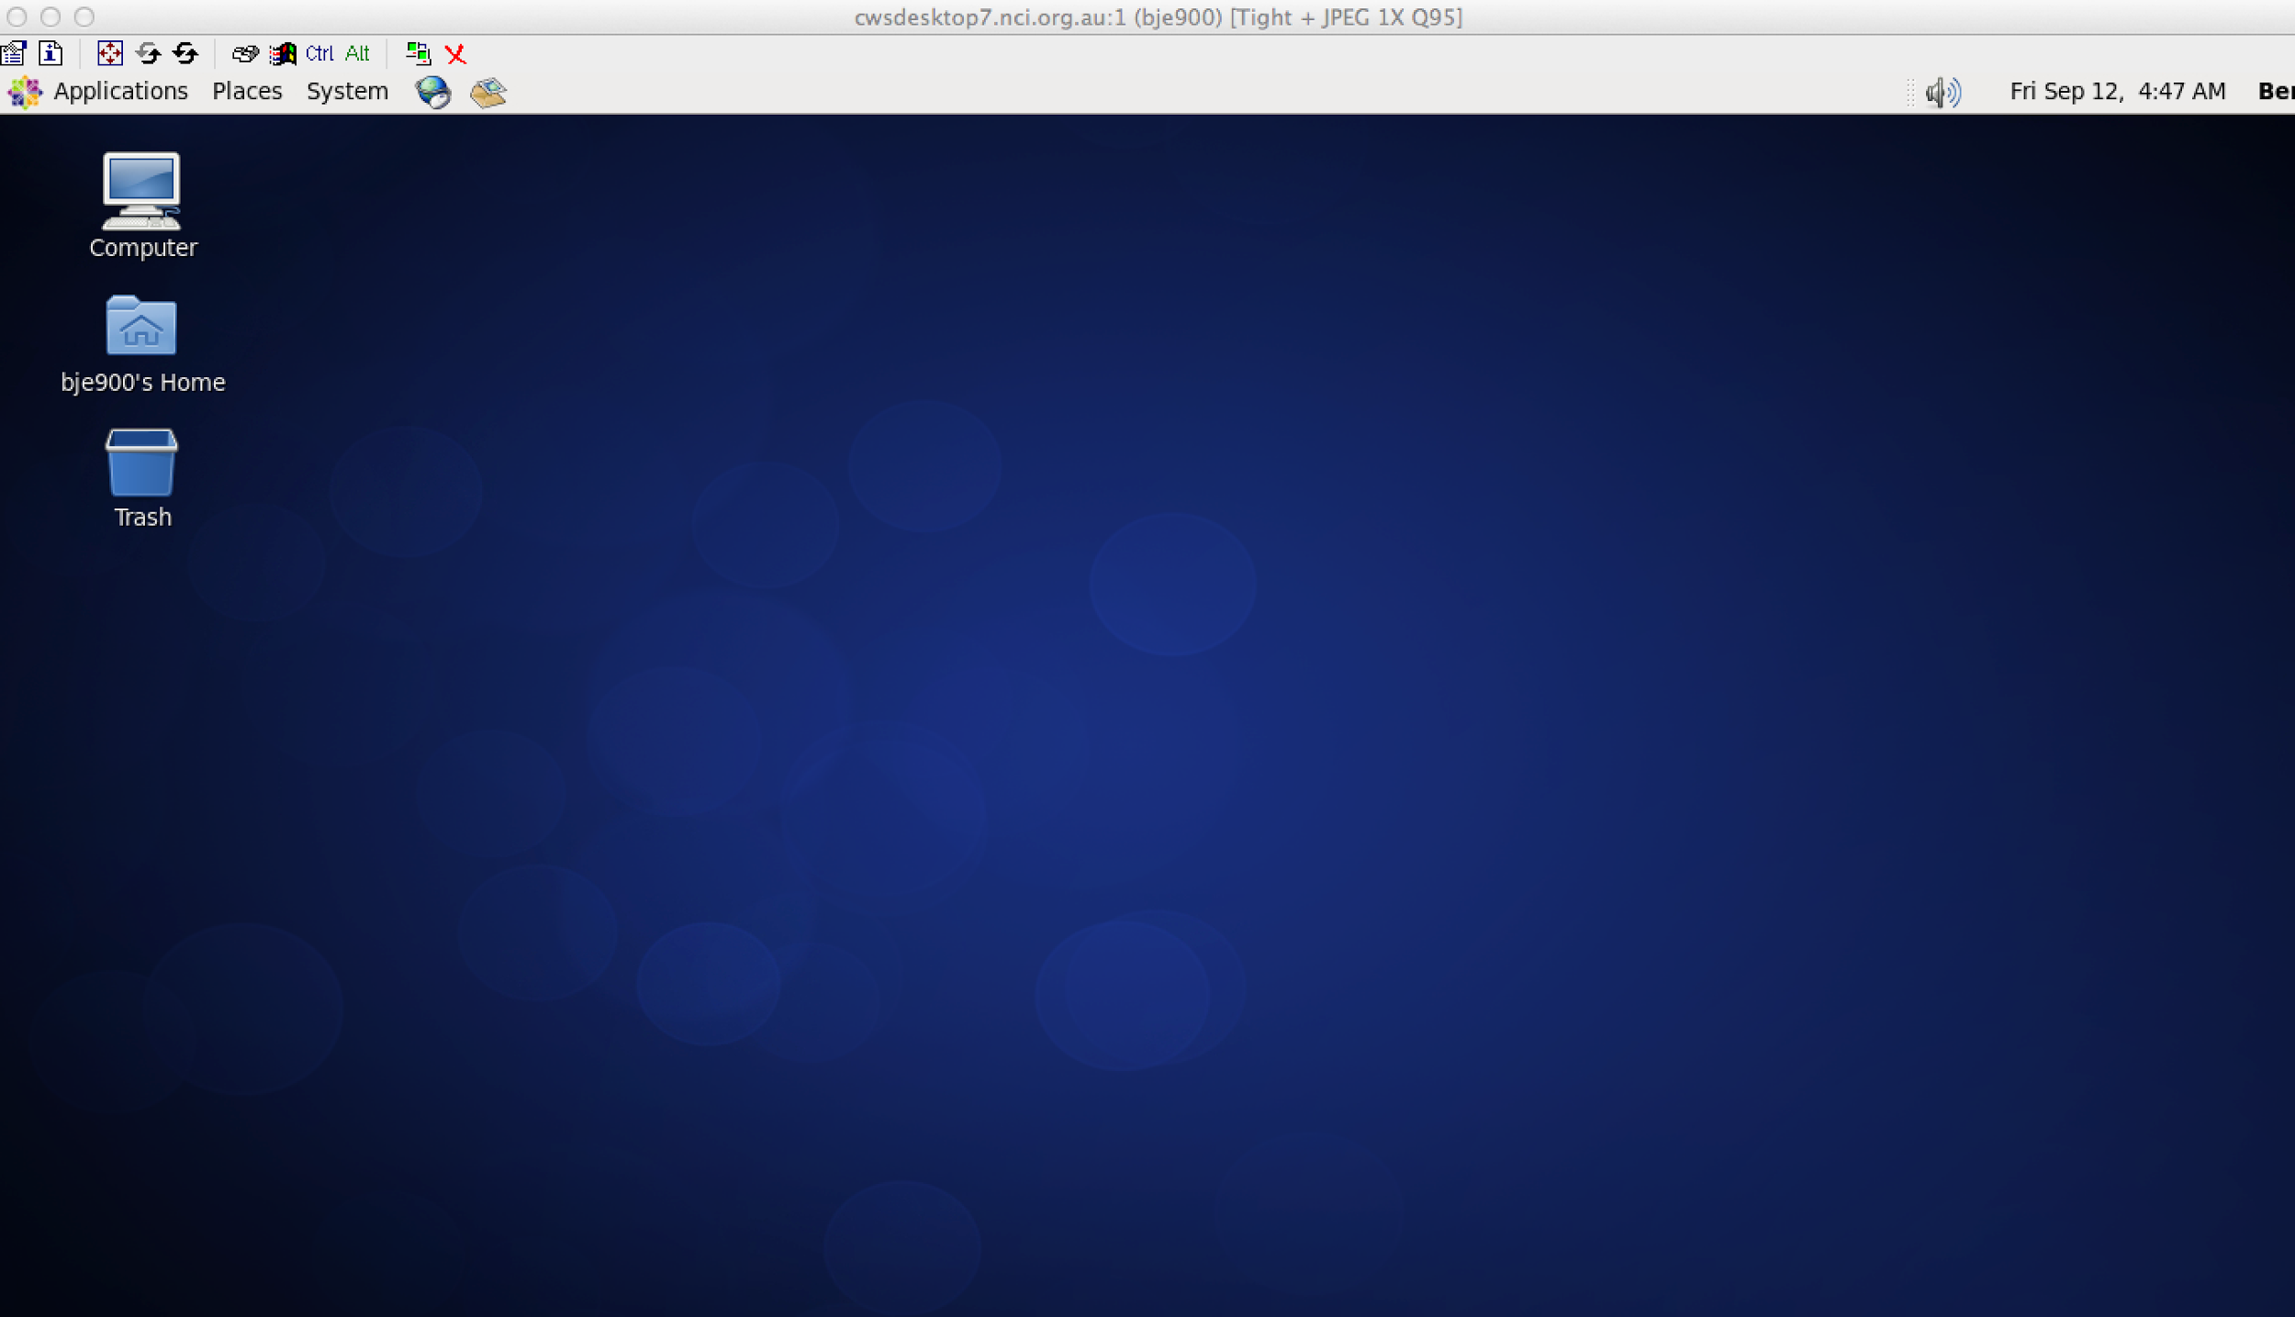
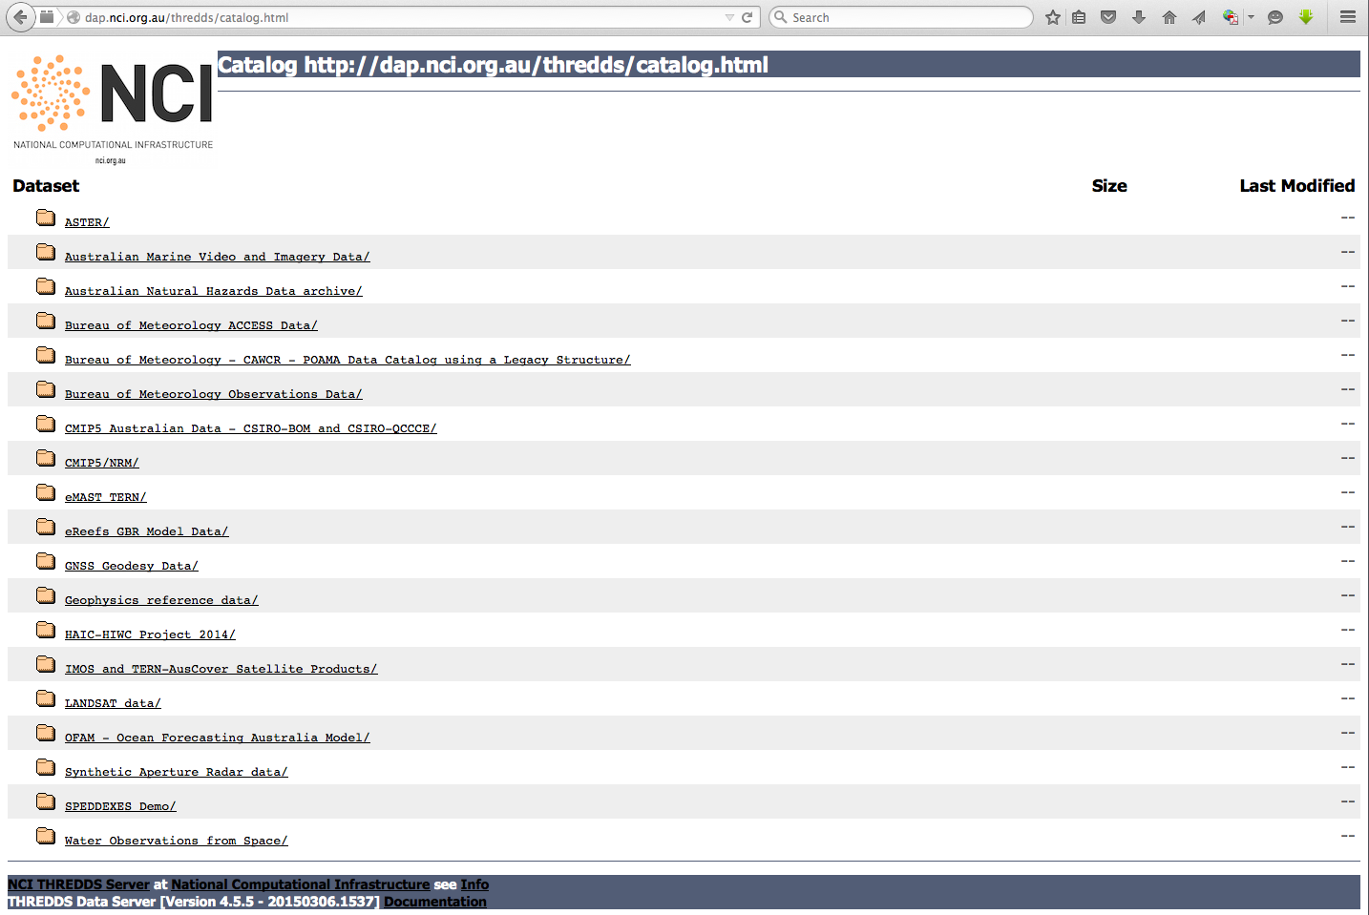
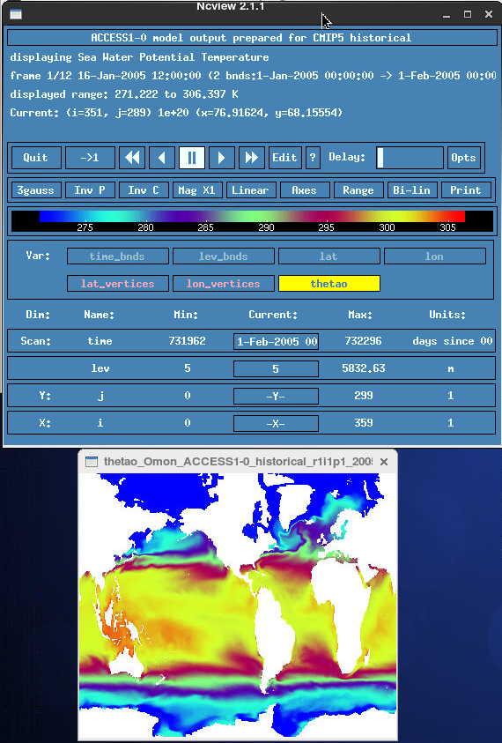
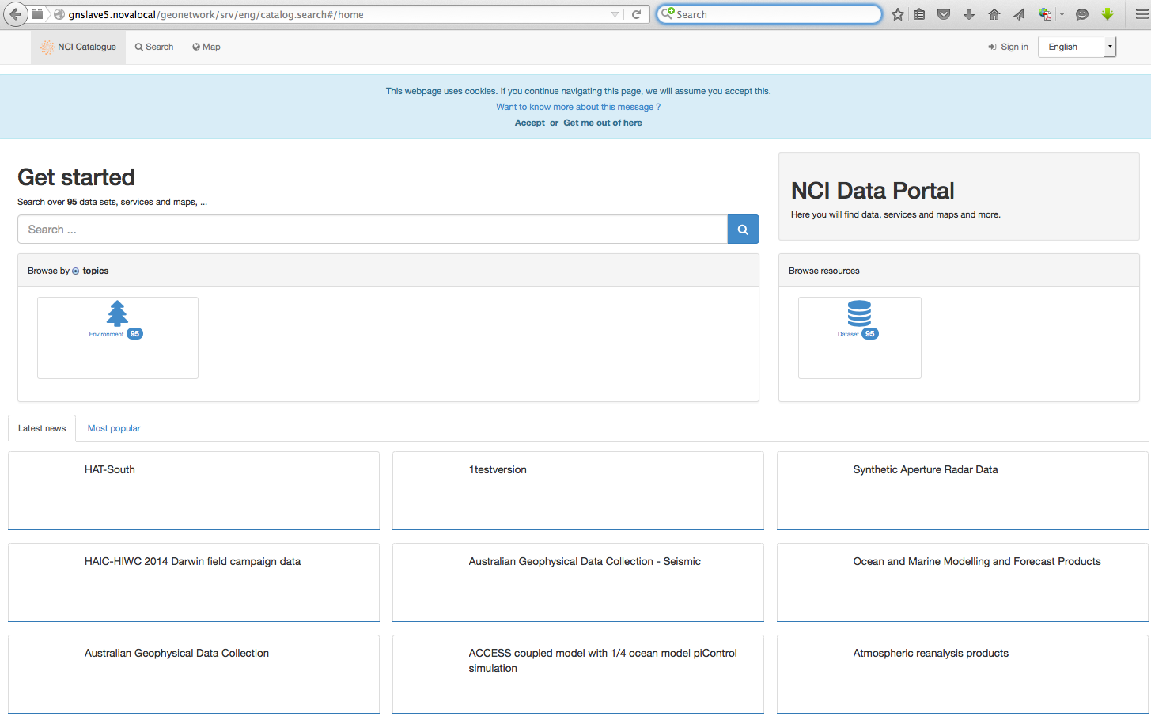
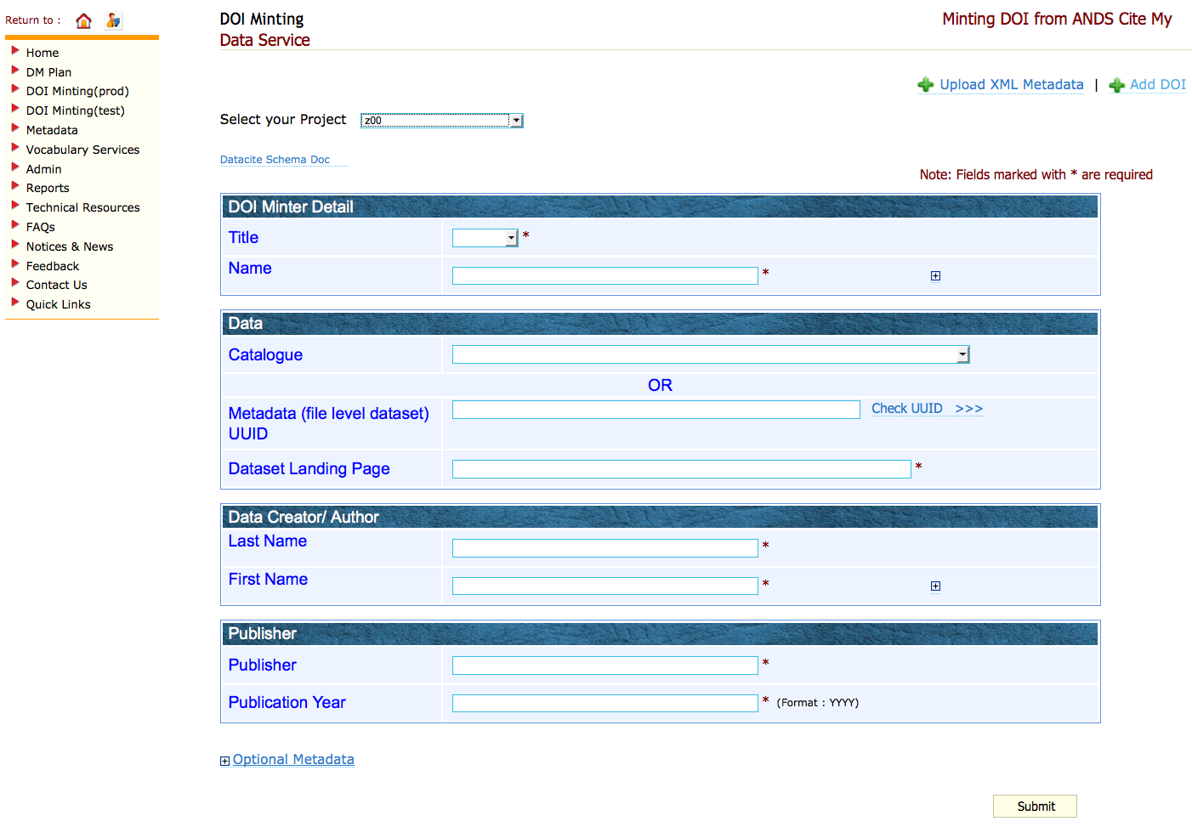
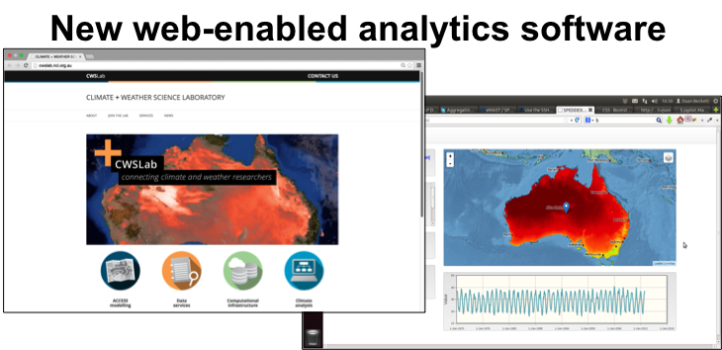
Overview
Data Manager fill DMP and create catalogue
User generate/transfer data
Super computer users
Paper and Data are published
Data visualization
Data share and re-use
NCI provides user with Data-as-a-Service
Visualisation tools
Web-time analytics software
HPC
Fast data storage
Data Management Portal
Data Curation, Publish, Citation

Slide 4
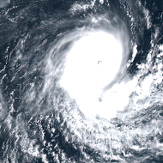
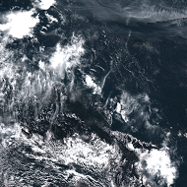
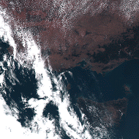
Range of data collections
1. Climate/ESS Model Assets and Data Products
2. Earth and Marine Observations and Data Products
3. Geoscience Collections
4. Terrestrial Ecosystems Collections
5. Water Management and Hydrology Collections
Data Collections | Approx. Capacity
CMIP5, CORDEX, ACCESS Models | 5 Pbytes
Satellite Earth Obs: LANDSAT, Himawari-8, Sentinel, MODIS, INSAR | 2 Pbytes
Digital Elevation, Bathymetry Onshore/Offshore Geophysics | 1 Pbytes
Seasonal Climate | 700 Tbytes
Bureau of Meteorology Observations | 350 Tbytes
Bureau of Meteorology Ocean-Marine | 350 Tbytes
Terrestrial Ecosystem | 290 Tbytes
Reanalysis products | 100 Tbytes

Slide 5
Overview
Data Collections | NCI project codes
CMIP6 replicated | oi10
CMIP5 Australian published / replicated | rr3 / al33
CMIP3 entire data collection | cb20
CORDEX | rr3, al33
Input4MIPs include JRA55-do (forcing for ocean/sea-ice models) | qv56
ERA-Interim (6hrly data) | ub4
ACCESS models (BoM) | rr3, rr4, ua4, ja4, gg6, gg8, fx1, fx3, ub3
LANDSAT, MODIS, VIIRS, AVHRR, INSAR, MERIS | rs0, fk4, u39, gb6
BoM Seasonal Climate | rr8, ub7
BoM Observations | rr5
BoM Ocean-Marine | rr6
ARCCSS/CLEX collections, including ERA-Interim (6hrly) | ua8, ub4
OFES, YOTC, ACCESS-CM, CABLE | rq5, rq7, gh5, wd9

Slide 6
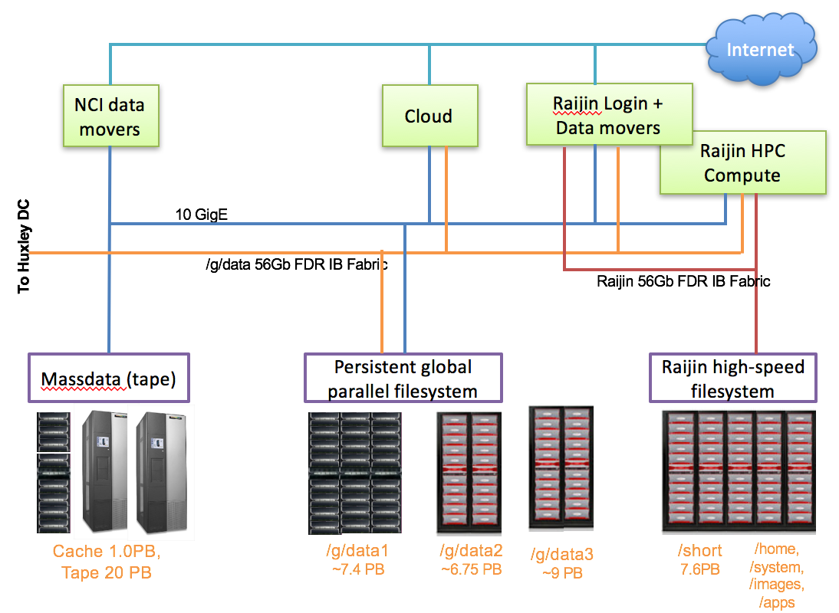
Overview
Datasets are stored on the NCI global filesystems. These are called:
/g/data1a
/g/data1b
/g/data2
/g/data3
On the VDI these are all symlinked from /g/data (you don’t have to remember the number).
The data stored on these filesystems are available to NCI’s raijin, the VDI, and data services.

Slide 7
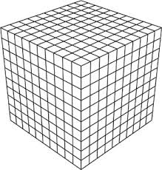


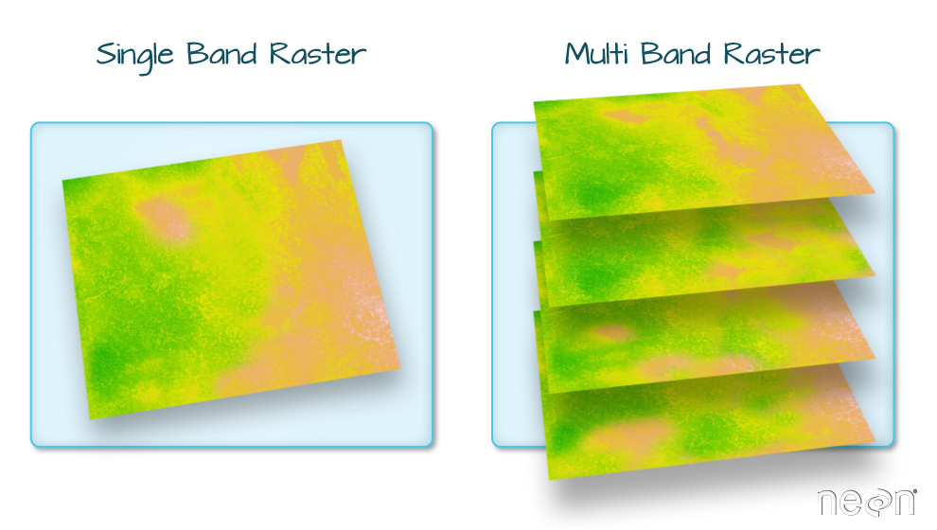

Types of data formats
Range of formats:
NetCDF/HDF5
GeoTIFF
GRIB
...
(Proprietary formats)
© National Computational Infrastructure 2018

Slide 8
NetCDF and HDF5
Network Common Data Form (NetCDF) &
Hierarchical Data Format (HDF5)
Support a wide variety of data types as well as data structures:
Scientific data arrays
Tables
Raster/image data
String data
Etc...
Used across large (and growing) spectrum of subject disciplines
Big pro: Common formats enable transdisciplinary interoperability.

Slide 9
NetCDF and HDF5
Network Common Data Form (NetCDF) & Hierarchical Data Format (HDF)
(from Unidata: http://www.unidata.ucar.edu/software/netcdf/docs/faq.html#whatisit)
Self-Describing. A netCDF file includes information about the data it contains.
Portable. A netCDF file can be accessed by computers with different ways of storing integers, characters, and floating-point numbers.
Scalable. A small subset of a large dataset may be accessed efficiently.
Appendable. Data may be appended to a properly structured netCDF file without copying the dataset or redefining its structure.
Sharable. One writer and multiple readers may simultaneously access the same netCDF file.
Archivable. Access to all earlier forms of netCDF data will be supported by current and future versions of the software.

Slide 10
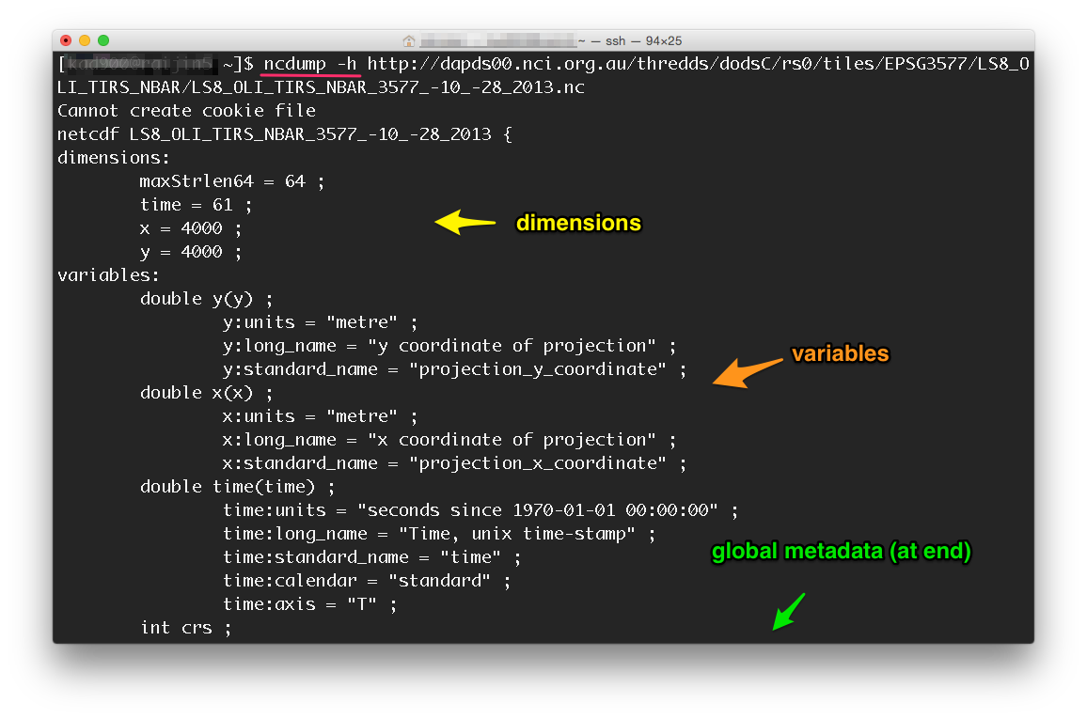
A quick look inside...
In particular, what does “self-describing” look like?
File metadata information
Dimensions
Variables
Variable-level metadata
Special attributes
Compression
Chunking
Endianness
© National Computational Infrastructure 2018

Slide 11
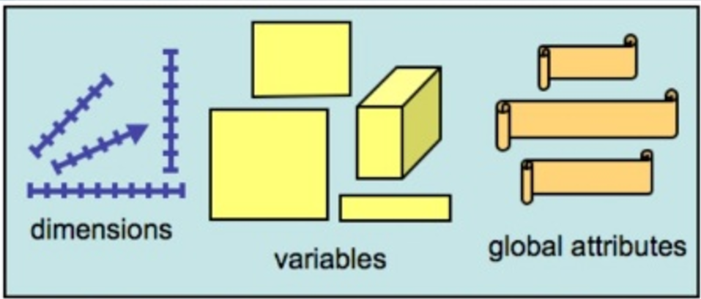
Types of NetCDF files
Classic Data Model:
NetCDF3 (or just “classic”)
64-bit offset format
Enhanced Data Model:
NetCDF4
NetCDF4-classic
http://www.slideshare.net/HDFEOS/netcdf4-tutorial-ws14
© National Computational Infrastructure 2018

Slide 12
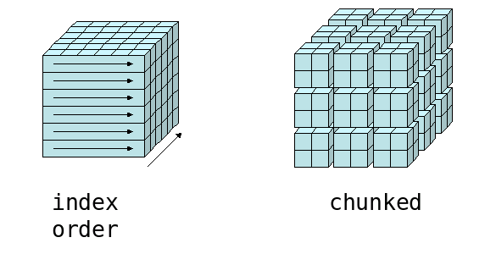
NetCDF/HDF5 Structure Concepts
NetCDF and HDF5 are multidimensional array data containers:
Tuning parameters affecting performance:
Order of dimensions
last dim is contiguous, rest are stridded.
Chunk shape
Dramatically speeds access along chunked dimensions.
Compression (per chunk)
Reduces size but slows access to individual chunks
Source: Unidata https://www.unidata.ucar.edu

Slide 13
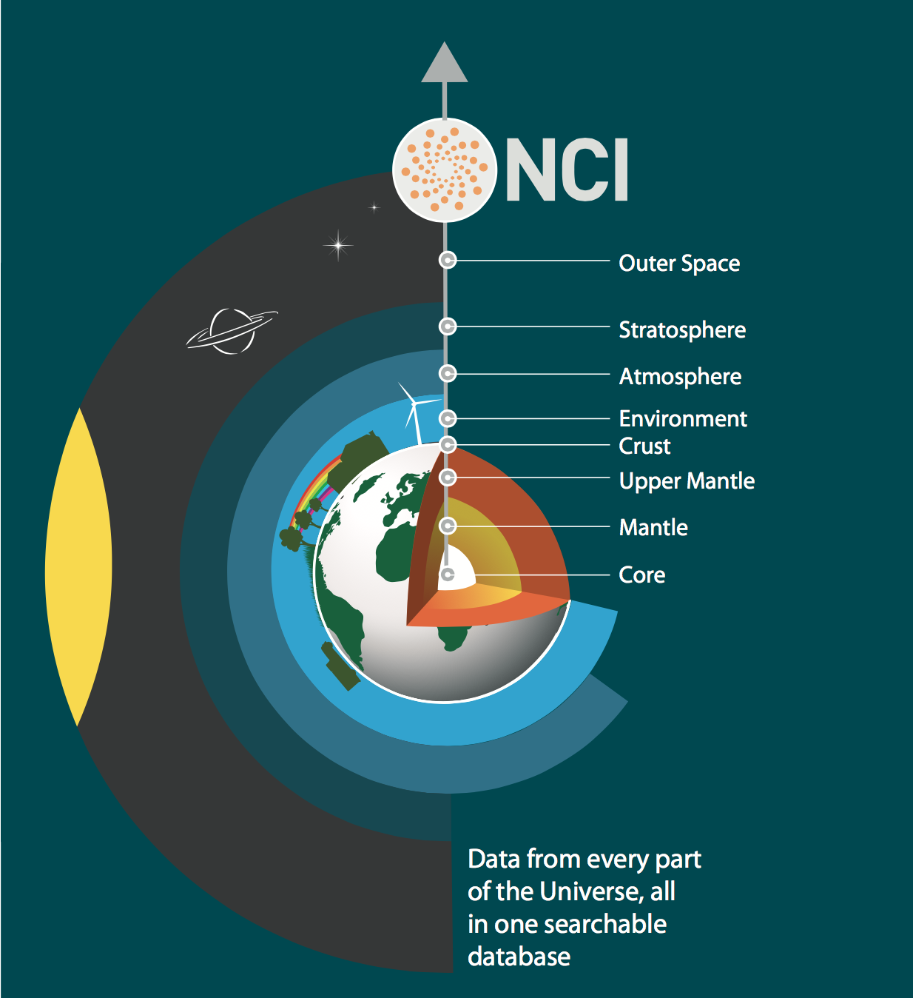
Why important?
Application of community-agreed data standards to the broad set of Earth systems and environmental data that are being used
Within these disciplines, data span a wide range of:
Gridded
Non-gridded (i.e., trajectories/profiles, point data)
Coordinate reference projections
Resolutions

Slide 14
Very quick overview of how Data Standards become an important aspect of data:
Usability
Interoperability

Slide 15
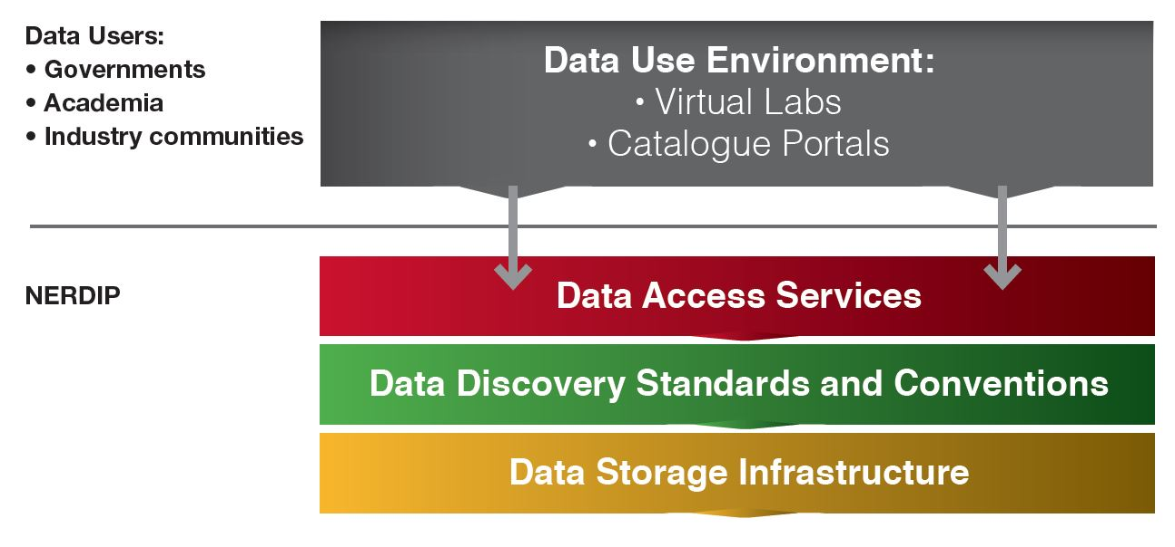
National Environmental Research Data Interoperability Platform (NERDIP)

Slide 16
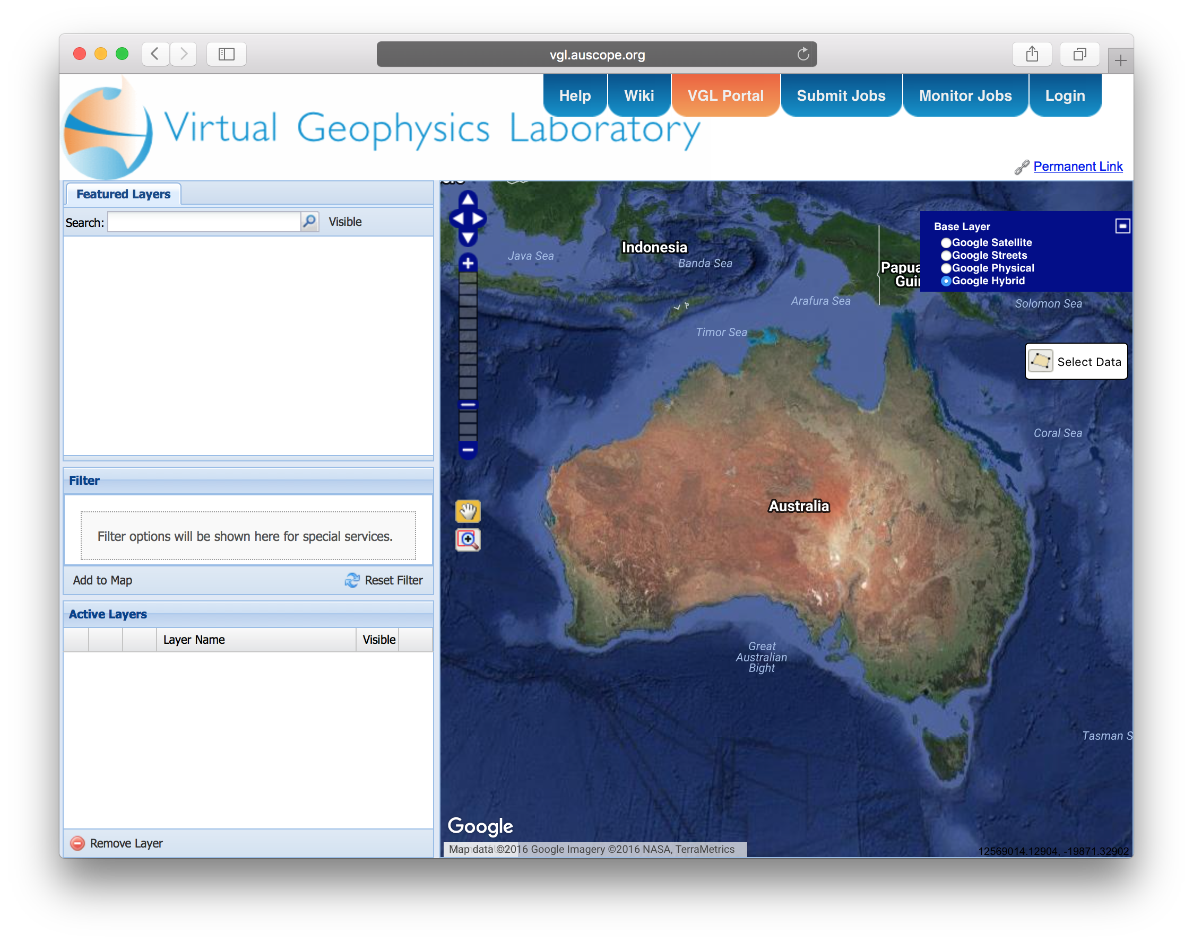
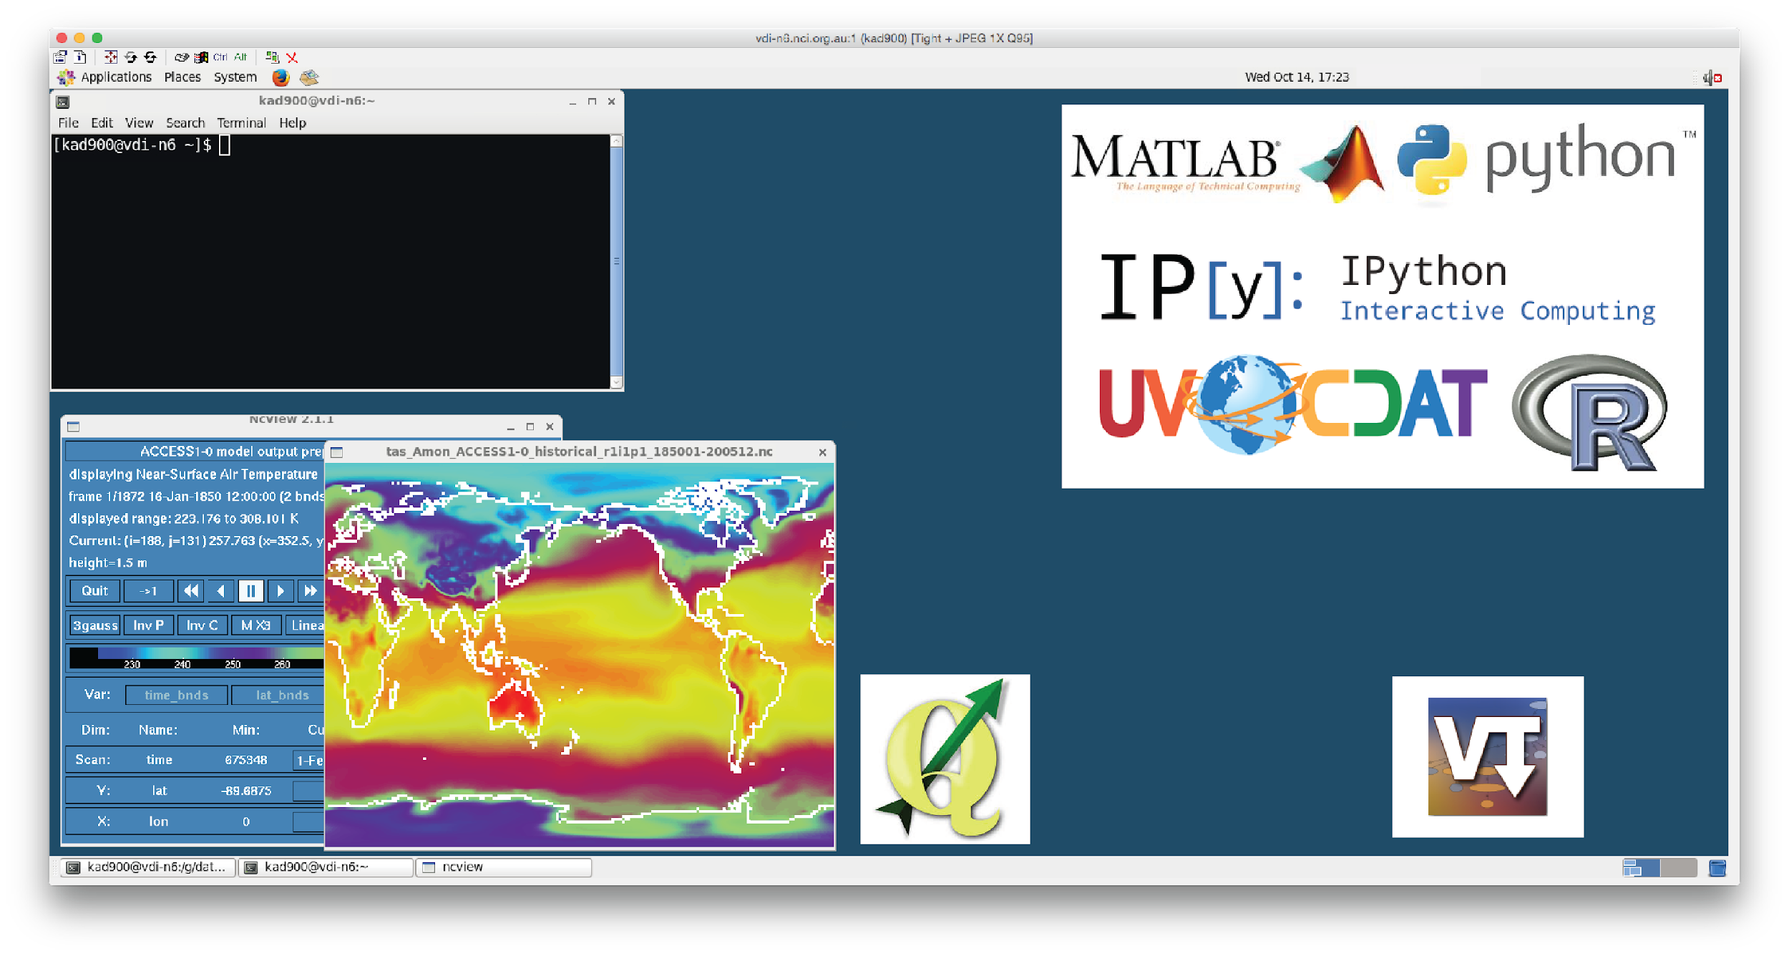
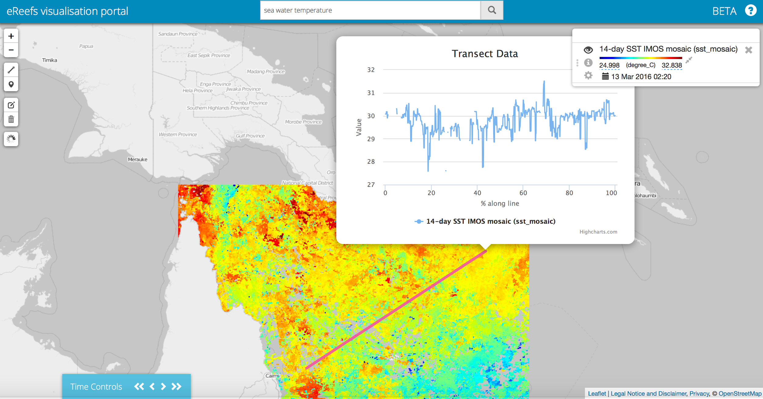
Enables broad range of access
Collections are being accessed and utilised from a broad range of options
Direct access on filesystem
Web and data services
Data portals
Virtual labs (e.g., virtual desktops)
eReefs online analysis portal

Slide 17
New HPC machine is coming!
NCI will NOT migrate the contents of Raijin /short to the new HPC system. All users are strongly encouraged to start archiving and cleaning up files in their /short directories as soon as possible. The Raijin /short file system is provided for temporary files only and is not backed up.
In June all NCI users will be asked to update their account passwords and acknowledge current terms and conditions of access for NCI.
Recertification is important for account and data security. It ensures only approved users have access to NCI systems and data, and that NCI and its users meet our mutual obligations under Commonwealth legislation, such as the Autonomous Sanctions Act and Defence Trade Controls Act.

